Slide 1

Introduction to AI (AI101B) Even Semester Session 2025-26
Simple AI Game for rock paper scissor
AASHI(202410116100004)
ANTRA PRAKASH(202410116100035)
AYUSH SAINI(202410116100046)
ADITYA SHARMA(202410116100011)
Project Supervisor:
Mr. Apoorv Jain

Slide 2
Introduction
This presentation delves into the game of Rock, Paper, Scissors, focusing on the fundamental mechanics and how artificial intelligence is transforming gameplay experiences.

Slide 3
01
Game Basics

Slide 4
Objective of the game
The objective of Rock, Paper, Scissors is simple: players must choose one of three options (rock, paper, or scissors) and play against an opponent's choice. The winner is determined by the rules: rock crushes scissors, scissors cuts paper, and paper covers rock. The game is often used to make decisions in a fun and engaging way.

Slide 5

Game rules
Each player simultaneously forms one of three shapes with their hand. The possible outcomes are a win, loss, or a tie. Players typically play in rounds, with a predetermined number of rounds or until a player reaches a winning score. The game emphasizes quick decision-making and can be influenced by psychological strategies.

Slide 6
Benefits of playing
Playing Rock, Paper, Scissors offers several benefits, including enhancing decision-making skills, promoting quick thinking, and providing an enjoyable experience that can serve as a stress reliever. The simplicity of the game allows players to engage in strategic thinking and psychological tactics, improving their cognitive flexibility.

Slide 7
02
AI Integration

Slide 8
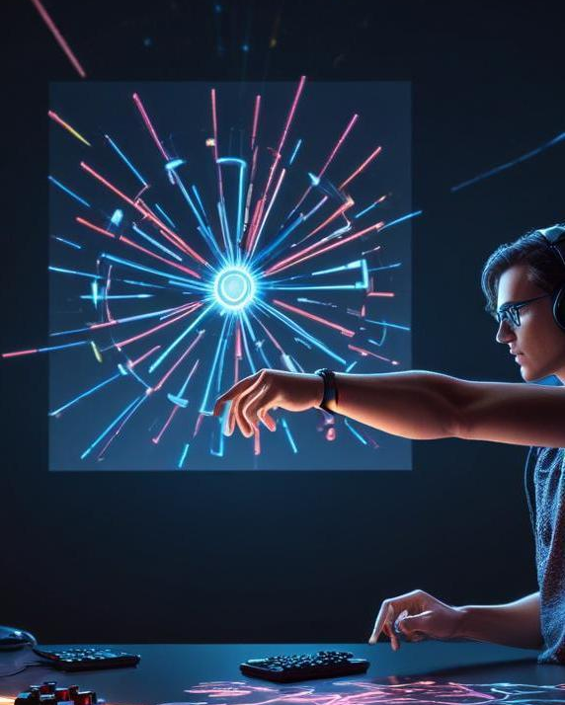
How AI enhances gameplay
Artificial Intelligence enhances Rock, Paper, Scissors by introducing complex strategies that can predict opponent moves, making the game more challenging and engaging. AI systems analyze player patterns and adapt strategies in real-time, providing a dynamic gaming experience.

Slide 9
Algorithms used by AI
Various algorithms, such as machine learning techniques and neural networks, are employed in AI systems for Rock, Paper, Scissors. These algorithms learn from past games, recognizing patterns in player choices to refine their decision-making processes. They can also use randomization to simulate human unpredictability.

Slide 10
Real-life applications of AI in gaming
AI in gaming extends beyond Rock, Paper, Scissors to more complex games and simulations. It is used for developing adaptive gameplay in video games, creating smarter NPCs (non-player characters), and enhancing user experiences through personalized gaming environments and challenges.

Slide 11
Conclusion
Rock, Paper, Scissors is not just a simple game; it serves as a platform for exploring AI capabilities in gaming. The integration of AI not only makes the game more exciting but also illustrates the potential of artificial intelligence to innovate and enhance user interactions across various gaming formats.

Slide 12
Thank you

